Slide 1
Predicting fraudulent transactions in a financial company

Slide 2
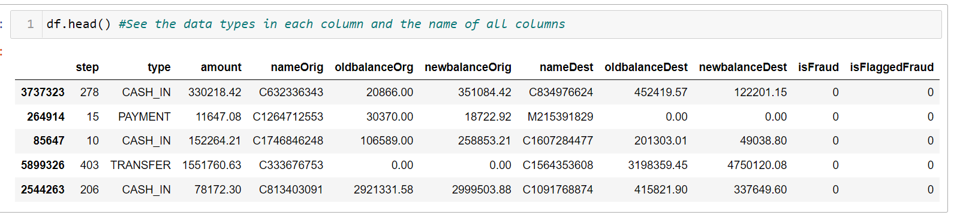
Data overview
Data frame dimension is 100k rows and 11 columns
Through df.head() we can see there is a irrelevant column, ‘step’ and a probably redundant column ‘isFraud’ and ‘isFlaggedFraud’ which could meant the same thing
‘nameOrig’ and ‘nameDest’ should also be removed to prevent bias

Slide 3
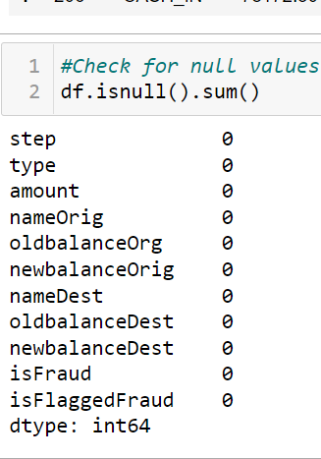
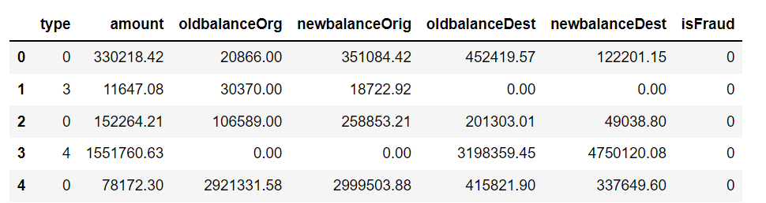
Data processing
Check for missing value
Do label encoding for type

Slide 4


Data cleaning(removing useless columns)
To ensure that ‘isFraud’ and ‘isFlaggedFraud’ is the same we have to check the unique values for the 2 columns
The unique values for both columns are 1 and 0, ‘isFraud’ makes more sense to be used as an outcome as there is more 1s compared to ‘isFlaggedFraud’ furthermore for ‘isFlaggedFraud’ has only 1 row with the value 1, we can consider to drop this if the value is also reflected on the ‘isFraud’ column else we can add this row in to ‘isFraud’ column

Slide 5
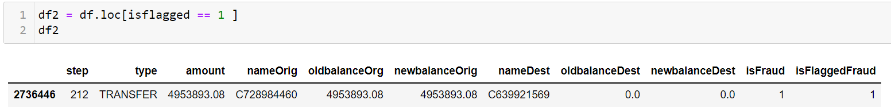
Data cleaning(removing useless columns)
It seems the value for ‘isFlaggedFraud’ is also reflected at ‘isFraud’ hence we will proceed to drop this column together with the column step

Slide 6
Visualization
From the correlation heat map only amount has a high positive correlation to fraud
From pairplot, there is no 2 features that can be used to identify fraud
Notes:
I`m bad at deciding which graph to use and interpreting graph

Slide 7
Model evaluation
Although the accuracy for decision tree classifier is higher but using K-fold validation the RMSE for logistic regression is much better, hence Logistic Regression is the better machine learning model for this dataset
Machine learning model | Accuracy | RMSE
Logistic Regression | 0.99916 | 0.03897158161776125
Decision tree classifier | 0.9995 | 0.031322047493458516
Notes:
No idea why, all types of decision tree usually should have better RMSE compared to rest of the supervised machine learning models but downside is decision tree takes longer to train

